Slide 1
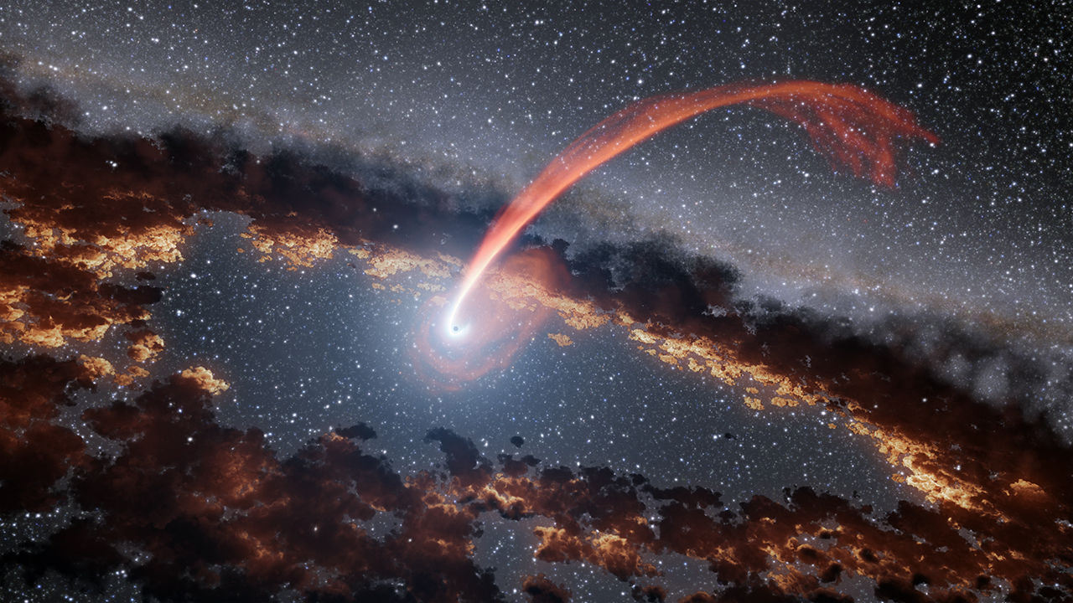
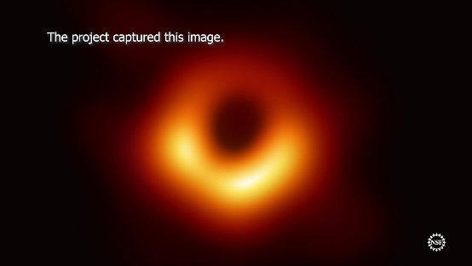
Review
Stars
A celestial object consisting of a luminous ball of plasma held together by its own gravity
Black Hole
extremely dense, with such strong gravitational attraction that even light cannot escape
Formed when very large stars collapse at the end of their life

Slide 2
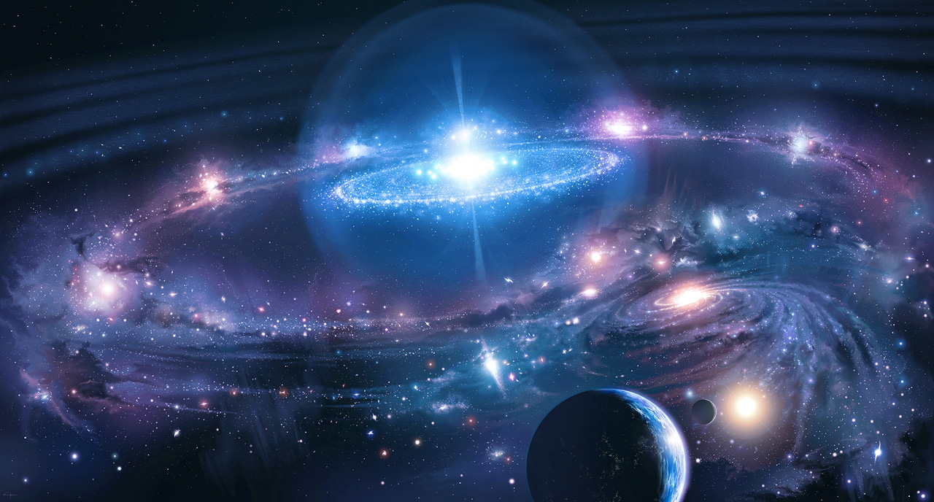
Life of a star

Slide 3
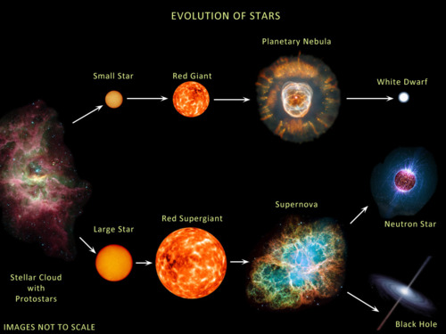
Lesson Objectives
Describe the process that forms a star
Describe the life cycle of a star
List and describe a variety of different types of stars
Activating prior knowledge
Our sun is an average star. At the end of its life what type of star will it turn into?

Slide 4
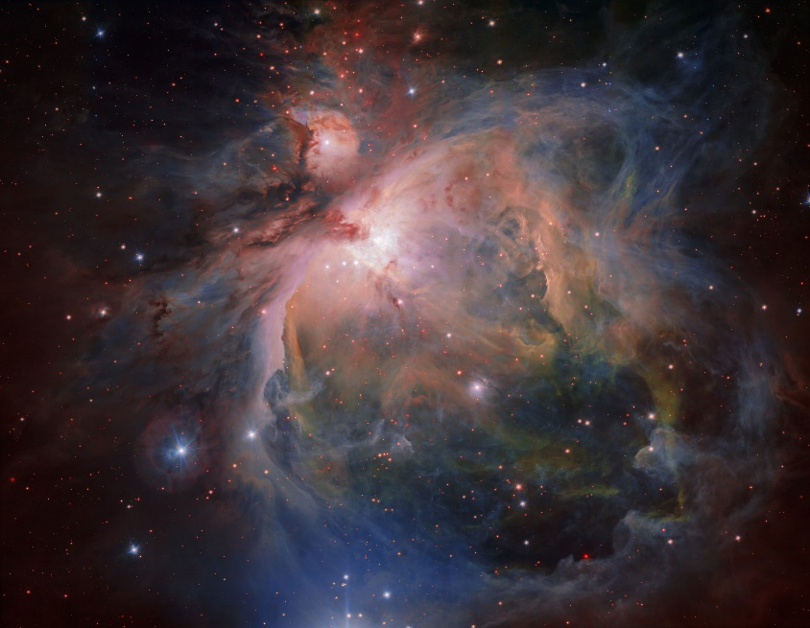
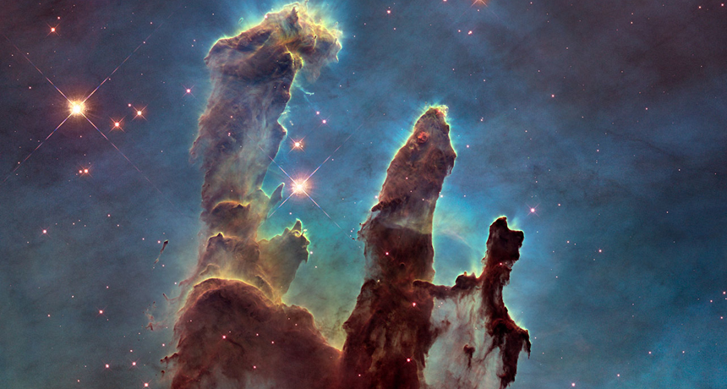
Birth of A stars
Stars form in a large cloud of dust and gas called a nebula
The atoms of hydrogen gas clump together due to their gravity
The atoms in the middle heat up due to pressure of atoms around it
Eventually there is enough heat and pressure to force hydrogen atoms to form helium in a process called nuclear fusion
We call this newly born star a protostar

Slide 5
Adult stars
Also called a main sequence star
The hydrogen-helium nuclear fusion occurs until the star runs out of hydrogen
2 types of adult star
Small star – like our sun, a smaller main sequence star
Large star – any sun 8 times larger (or more) than ours
Both of these stars are fuelled by a hydrogen-helium nuclear reaction

Slide 6
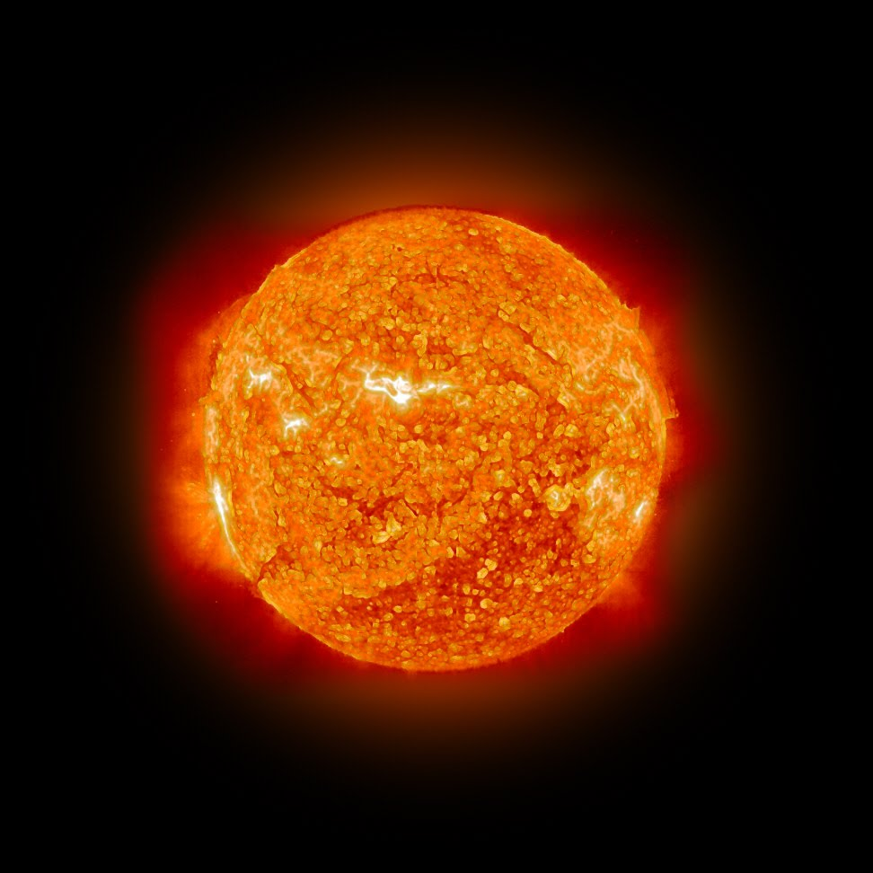
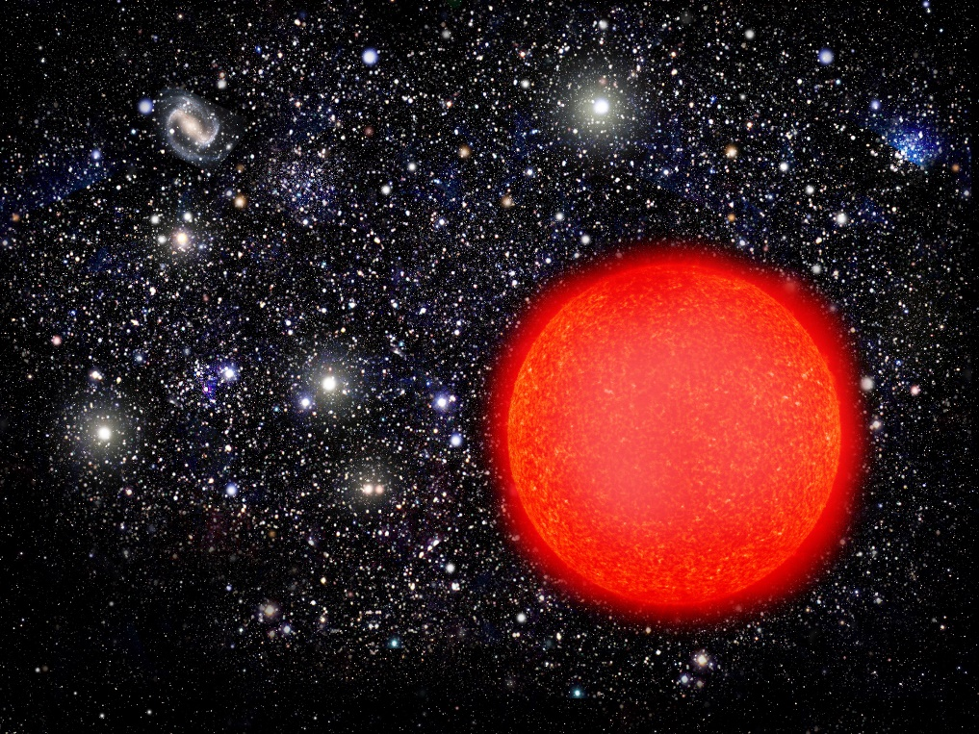
Older stars
As the available hydrogen decreases the helium atoms are pulled to the centre of the star
The pressure and temperature in the centre of the star increases
This fuses helium atoms together – forming carbon atoms
This releases more energy than hydrogen fusion
As this happens the star cools and expands

Slide 7
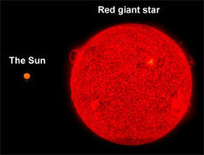
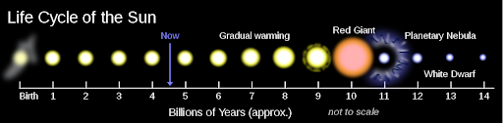
Older stars
The star now grows larger to form:
Red giant – if forming from a small size star
Red supergiant– if forming from a large star
This will happen to our Sun in about 5 billion years – the sun will swallow the 4 planets in the solar system.

Slide 8
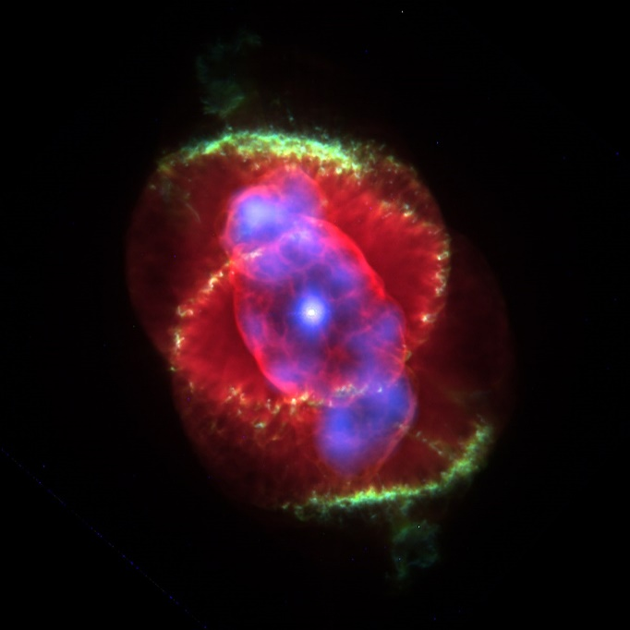
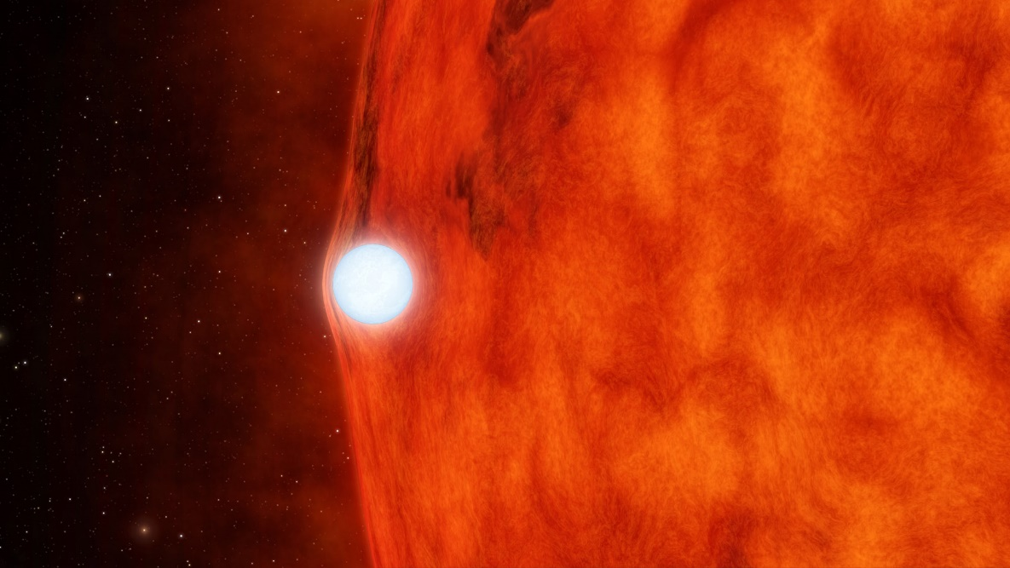
Death of a star – Red giant
As eventually the amount of helium in the star decreases
The outer region of the red giant fades, and becomes a planetary nebula
Only the core of the red giant remains at the centre of the nebula
The core then becomes white hot and is called a white dwarf which gradually fades

Slide 9
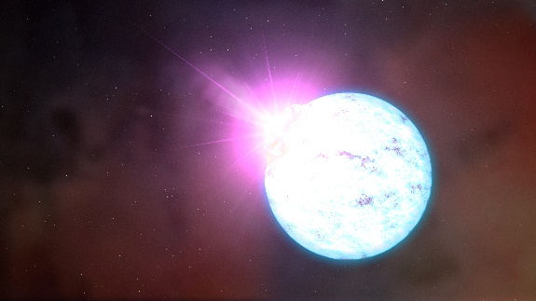
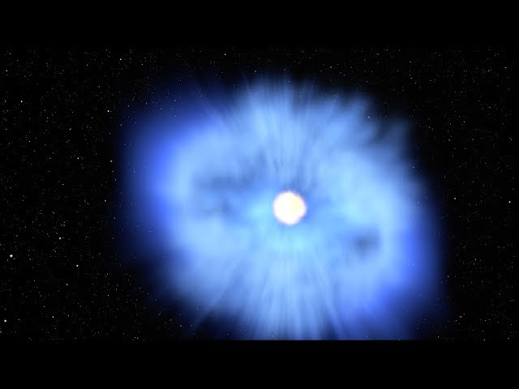
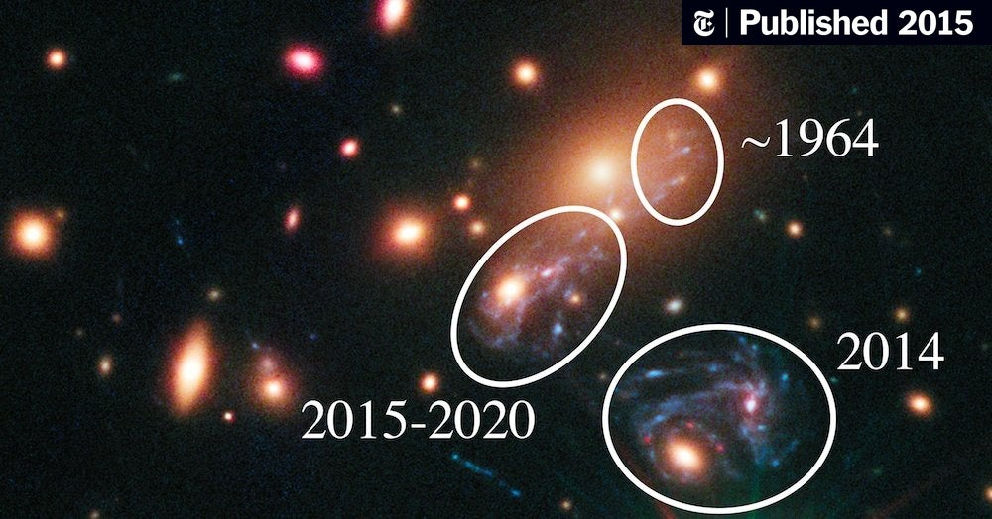
Death of a star – Red supergiant
As eventually the amount of helium in the star decreases
The fusion process continues until iron is formed
Eventually the star runs out of energy and collapses leading to an explosion called a supernova
After the supernova the amazingly dense core of the super giant remains creating a neutron star
When the most massive stars supernova – the core that is left behind is dense that it collapses forming a black hole

Slide 10
Skill closure
Which element is undergoing fusion nuclear reaction in a main sequence star?
Which star forms when a large main sequence star runs out of fuel?
What type of star will our Sun turn into at the end of its life?

Slide 11
Independent Practice
Complete the “Stars Worksheet” on connect
https://www.youtube.com/watch?v=BG-ukUB_sQU

